Slide 1
Chapter 9: Validity (Part 2)

Slide 2
Introduction
Need to Belong Scale (NTBS):
  Measures degree of interpersonal acceptance.
  Assumed to be a fundamental need, but varies?
If NTBS scores truly reflect need to belong, then scores should positively/negatively correlated with some scales and not correlate w/ others
Examples?
Notes:
Need to Belong Scale:
It was intended to measure the degree to which individuals desire “interpersonal acceptance and belonging.”
Although this is hypothesized as a fundamental human need, the researchers observed that people differ in the degree to which they experience this need.
In reality, some people have a relatively great need to experience frequent interactions within close and caring relationships, while others seem to need less interactions.
Association of NTBS scores with other scales and measures: If NTBS scores do indeed reflect the need to belong, then the researchers expected to find a particular pattern of associations wherein NTBS scores should be strongly positively associated with some scales, negatively associated with other scales, and not associated with yet other scales.

Slide 3
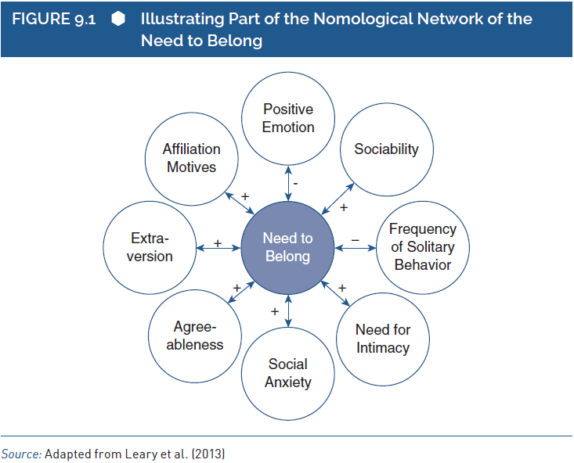
A Construct’s Nomological Network (1 of 2)
Notes:
Two key questions of construct’s nomological network:
First question is when examining construct validity, how do researchers know which other scales and measures to examine?
Second question is how do researchers know which pattern of convergent and discriminant associations to expect?
Consideration of theoretical context:
To properly evaluate the validity of a scale that is intended to reflect a given construct, researchers carefully consider the theoretical context around that construct.
Researchers think carefully about the meaning of the construct in terms of other constructs behaviors or properties.
They also analyze which other psychological constructs are similar or different to the construct in question.
If there are groups of people who should have different levels of the construct.
If there are groups having different levels.
They also think if there are there long-term consequences likely to be associated with the construct.
Understanding a construct’s nomological network:
By situating a construct in the context of other constructs, behaviors, or properties, researchers sharpen and articulate the very meaning of the construct itself.
This network of associated constructs, behaviors, and properties is the construct’s nomological network, which refers to the network of “meaning” surrounding a construct.
Features of nomological network:
When examining convergent and discriminant associations of a measure, researchers examine the constructs, behaviors, and properties within a specific nomological network.
Understanding a construct’s nomological network tells researchers how their measure should be related to measures of other constructs, behaviors, and properties.
It tells researchers whether their measure should be strongly positively correlated, strongly negatively correlated, moderately positively correlated, uncorrelated, and so on with other constructs and behaviors.
The nomological network of associations among constructs dictates a particular pattern of associations among measures of those constructs.
The nomological network surrounding a construct suggests that a measure of the construct should be strongly associated with measures of some constructs but weakly correlated with measures of other constructs.

Slide 4
A Construct’s Nomological Network (2 of 2)
Two key questions:
  How to know which other scales/measures to examine?
  How to know what pattern of associations to expect?
Theory is important!
Examine the network!
  Do associations match predictions?
Notes:
Two key questions of construct’s nomological network:
First question is when examining construct validity, how do researchers know which other scales and measures to examine?
Second question is how do researchers know which pattern of convergent and discriminant associations to expect?
Consideration of theoretical context:
To properly evaluate the validity of a scale that is intended to reflect a given construct, researchers carefully consider the theoretical context around that construct.
Researchers think carefully about the meaning of the construct in terms of other constructs behaviors or properties.
They also analyze which other psychological constructs are similar or different to the construct in question.
If there are groups of people who should have different levels of the construct.
If there are groups having different levels.
They also think if there are there long-term consequences likely to be associated with the construct.
Understanding a construct’s nomological network:
By situating a construct in the context of other constructs, behaviors, or properties, researchers sharpen and articulate the very meaning of the construct itself.
This network of associated constructs, behaviors, and properties is the construct’s nomological network, which refers to the network of “meaning” surrounding a construct.
Features of nomological network:
When examining convergent and discriminant associations of a measure, researchers examine the constructs, behaviors, and properties within a specific nomological network.
Understanding a construct’s nomological network tells researchers how their measure should be related to measures of other constructs, behaviors, and properties.
It tells researchers whether their measure should be strongly positively correlated, strongly negatively correlated, moderately positively correlated, uncorrelated, and so on with other constructs and behaviors.
The nomological network of associations among constructs dictates a particular pattern of associations among measures of those constructs.
The nomological network surrounding a construct suggests that a measure of the construct should be strongly associated with measures of some constructs but weakly correlated with measures of other constructs.

Slide 5
Assessing Convergent and Discriminant Validity (1 of 6)
Associations between test scores and important variables
  If associations are verified:
    Strong validity ☺
  If not:
    Serious doubts ☹
Example: The SAT
  Goal of the test?
  What variables might be important for evaluating it?
Validity generalization: evaluate a test’s validity using a range of settings, times, situations, etc.
Notes:
Focus of evaluating validity:
Evaluating the validity of interpretations for such measures can focus on the associations between test scores and those particularly important criterion variables.
Research verifying those crucial predicted associations provides strong validity evidence, but research failing to verify the associations casts serious doubts on validity.
Features of SAT:
The SAT is intended to reflect the content knowledge and cognitive processes that students need to be ready for admission and be successful in college.
There are two kinds of variables that might be particularly critical for evaluating the SAT.
First, SAT scores should be associated with other measures of those types of knowledge and processes.
Second, because they are intended to assess constructs required for success in college, SAT scores should be associated with measures of collegiate academic performance.
In establishing the psychometric quality of the SAT, the college board appears to be most concerned with the latter issue.
Several documents that are made available to students, educators, and prospective researchers emphasize the correlation between SAT scores and academic indicators such as grades of first year.
The college board clearly focuses its validity argument heavily on the correlations between the SAT and a very specific set of criterion variables related to academic performance in college.
Validity coefficients:
One method for evaluating the validity of test interpretations is to focus on a few highly relevant criterion variables.
To the degree that test scores are indeed correlated with those crucial variables, test developers and test users gain increased confidence in the test.
Those correlations, sometimes called validity coefficients, are fundamental for establishing validity.
If research reveals that a test’s validity coefficients are generally large, then test developers, users, and evaluators have increased confidence in the quality of the test as a measure of its intended construct.
Validity generalization:
It is a process of evaluating a test’s validity coefficients across a large set of studies.
Validity generalization studies are intended to evaluate the predictive utility of a test’s scores across a range of settings, times, situations, and so on.
This study is a form of meta-analysis; it combines the results of several smaller individual studies into one large analysis.
A validity generalization study evaluates the degree to which the association between a test and an important criterion variable generalizes across individual studies that cover a range of populations, settings, and so on.

Slide 6
Assessing Convergent and Discriminant Validity (2 of 6)
More common: A single validity study
  Recruit ~50 to 400 participants, assess measure and related measure, test for correlation between scores
  Why smaller samples?
  Potential problems?
Notes:
Significance of single validity study:
Mostly a researcher conducting a single validity study will recruit a sample of 50–400 participants, administer the measure of interest to those participants, assess additional criterion variables deemed relevant, and compute the correlation between the scores on the measure of interest and scores on the criterion measures.
Such studies are the basis of many measures used for research in personality psychology, clinical psychology, developmental psychology, social psychology, organizational psychology, and educational psychology.
All these studies include relatively small samples due to limits on researchers’ time, funding, and other resources.
The only drawback of this study is that study conducted at one location with one type of sample might produce results that do not generalize to another location or another type of sample.
NEO-PI-R conscientiousness scale:
The results of a study of bank employees might demonstrate that scores on the Revised NEO Personality Inventory (NEO-PI-R) conscientiousness scale are relatively good predictors of job performance for bank tellers.
If the trait of conscientiousness is more relevant for some kinds of jobs than for others, then one should not assume that it is a valid predictor of job performance in all professions.
Three important issues of validity generalization study:
First, they can reveal the general level of predictive validity across all of the smaller individual studies.
Second, validity generalization studies can reveal the degree of variability among the smaller individual studies.
The third issue that can be addressed by validity generalization studies is the source of variability among studies.
Reasons for results of studies to differ:
One reason is that the studies are based on different methods.
The differences in the measurement of the criterion variable contribute to differences in the size of the validity coefficient.
This kind of methodological source of variability should be considered when evaluating the implications of the general level and variability of validity coefficients across studies.
Another reason that validity studies might produce different results is that they reflect psychologically meaningful substantive differences.
This substantive difference may provide insight into the fundamental links between conscientiousness and job performance, and it would certainly have implications for use and interpretation of the scale itself.

Slide 7
Assessing Convergent and Discriminant Validity (3 of 6)
Potential problem w/ correlations?
  Inherent ambiguity in correlation between two measures.
  Presence == Same method or same constructs?
Notes:
Inherent ambiguity in correlation between two measures:
Due to the potential influences of trait variance and method variance, a correlation between two measures is a somewhat ambiguous finding.
On one hand, a strong correlation could indicate that the two measures share trait variance that is the psychological constructs that they are intended to measure truly do have some commonality.
On the other hand, a strong correlation either positive or negative could indicate that the two measures share method variance that is the measures are correlated mainly because they are based on the same method of measurement.
The ambiguity inherent in a correlation between two measures cuts both ways; it also complicates the interpretation of a weak correlation.
These ambiguities can create confusion when evaluating construct validity.
Focus on two correlation factors:
First is the correlation between the self-report measure of social skill and the acquaintance-report measure of social skill.
Second is the correlation between the self-report measure of social skill and the self-report measure of emotional stability.
Predicting first correlation to be stronger than the second:
Based on a consideration of the constructs being measured, the researchers might predict that the first correlation will be stronger than the second.
They might expect the first correlation to be quite strong as it is based on measures of the same construct and expect the second correlation to be relatively weak as social skill and emotional stability are different constructs.
But, based on a consideration of method variance, the researchers might expect to find that the first correlation is weaker than the second.

Slide 8
Assessing Convergent and Discriminant Validity (4 of 6)
 |  | POTENTIAL EXPLANATIONS
 |  | Trait Based | Method Based
RESULT | Strong Correlation | Same Trait (e.g., two measures of the same or similar traits) | Same Method (e.g., two measures based on the same method)
 | Weak Correlation | Different Trait (e.g., two measures of very different traits) | Different Method (e.g., two measures based on different methods)
Notes:
Figure 9.4: Trait similarity/differences and method similarity/differences as explanations for validity correlations.

Slide 9
Assessing Convergent and Discriminant Validity (5 of 6)
QVC Procedure: Quantifies the “fit” between theory-based predictions and the actual observed pattern of correlations
  QVC = Quantifying Construct Validity
Provides effect sizes (quantified size of difference) and tests for statistical significance (probability of obtaining result by chance)
Why? Correlations are usually “eye-balled”
Notes:
Quantifying construct validity:
A recently developed method by Westen and Rosenthal for evaluating convergent and discriminant validity evidence.
The researchers use the QCV procedure to formally quantify the degree of “fit” between:
Their theoretical predictions for a set of convergent and discriminant correlations.
The set of correlations that are actually obtained.
QCV procedure was designed to provide a more precise and more objective quantitative estimate of the support provided by the overall pattern of evidence.
The QCV procedure allows researchers to go beyond a subjective visual inspection, and concretely quantify the fit.
Imprecise interpretation of correlation:
The “sets of correlations” approach section stated that researchers often “eyeball” the correlations and make a subjective judgment.
Problem arises when one researcher’s subjective judgment does not agree with another’s judgment.
In the same way in MTMMM correlations, it was stated that some correlations were “generally larger” or “noticeably lower” than others.
This shows that although the correlations themselves are precise estimates of association, the interpretation of the overall pattern of convergent and discriminant correlations often has been done in a somewhat imprecise and subjective manner.
Two kinds of results obtained in a QCV analysis:
First, researchers obtain two effect sizes representing the degree of fit between the actual pattern of correlations and the predicted pattern of correlations.
These effect sizes, called r_{alerting-CV} and r_{contrast-CV}, are correlations themselves, ranging between –1 and +1.
Large positive effect sizes provide evidence of convergent and discriminant validity.
The second kind of result obtained in a QCV analysis is a test of statistical significance.
This test indicates whether the degree of fit between actual and predicted correlations is likely to have occurred by chance.
Researchers conducting a validity study using the QCV procedure will hope to obtain large values for the two effect sizes, along with statistically significant results.
QCV procedure in three phases:
Researchers must generate clear predictions about the pattern of convergent and discriminant validity correlations expected to find.
In second phase, researchers collect data and compute the actual convergent and discriminant validity correlations.
In the final phase of QCV procedure, researchers quantify the degree to which the actual pattern of convergent and discriminant correlations fits the predicted pattern of correlations.

Slide 10
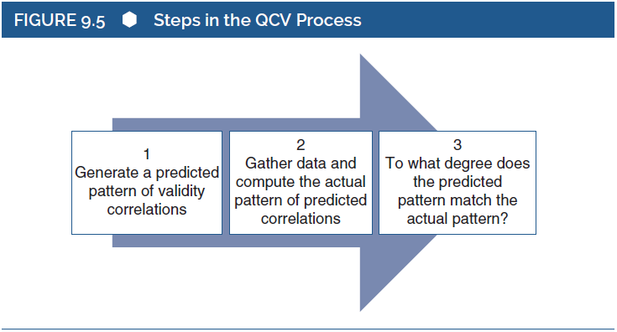
Assessing Convergent and Discriminant Validity (6 of 6)
Notes:
Figure 9.5: Steps in the QCV process.

Slide 11
Factors Affecting a Validity Coefficient (1 of 3)
Level of “true” association between constructs.
  If true association is high, measured correlation should be high
  Or vice versa
We tend to interpret observed correlations as approximating true association
Notes:
Factor affecting correlation:
One factor affecting the correlation between measures of two constructs is the “true” association between those constructs.
When two constructs are strongly associated with each other, then measures of those constructs will likely be highly correlated with each other.
On the contrary, if two constructs are unrelated to each other, then measures of those constructs will probably be weakly correlated with each other.
Findings of general and validity research:
When conducting general research, we intend to interpret the observed associations that we obtain as approximations of the true associations between the constructs in which we are interested.
When we conduct validity research, we predict that two measures will be correlated because we believe that the two constructs are associated with each other.

Slide 12
Factors Affecting a Validity Coefficient (2 of 3)
Random measurement error
Reliability of tests
Guidelines for identifying problematic levels of reliability:
  Reliability above .70 == ☺
  If reliability is low:
    Is there a different measure you can use?
Notes:
Implication of random measurement error:
An important implication of random measurement error is its effect on correlations between tests, it reduces, or attenuates, the correlation between tests.
Therefore, random measurement error affects validity coefficients, just like any other correlation.
The correlation between tests (say X and Y) of two constructs is a function of the true correlation between the two constructs and the reliabilities of the two tests.
Factors affecting validity coefficient:
First is the reliability of the test of interest and second is the reliability of the criterion test.
Thus, the primary test of interest could be a good measure of the intended construct, but the validity coefficient could appear to be poor.
Evaluating validity correlation:
While evaluating a validity correlation, one should consider both the reliability of the focal test and the reliability of the criterion test.
Even if any one or both is relatively weak, then the resulting validity correlation will appear relatively weak.
This might be subtle consideration for the criterion variable.
When the criterion measures that we use are poor, then we are unlikely to find evidence supporting the validity of the primary test.
Guidelines for identifying problematic levels of reliability:
When score of test’s reliability is above .70 or .80, then researchers are happy.
If a test’s or a criterion variable’s reliability is much lower than this, then we would have concerns about its effect on validity coefficients.
There are two possibilities for handling problems:
One is to simply discount a validity coefficient that is based on poor reliability, or at least to reduce the weight that you give it when considering validity evidence.
Second is to use the logic of the correction for attenuation.

Slide 13
Factors Affecting a Validity Coefficient (3 of 3)
Time:
  Validity measures taken at two different times are likely to be smaller than if bother measures are taken together
  More difference w/ more length between them. Why?
Notes:
Evaluating validity with respect to time: Validity is sometimes evaluated by examining the correlation between a test given at one point in time and a criterion variable measured at a later point in time.
Change in validity coefficients in relation to time:
All others being equal, validity coefficients based on correlations between variables measured at different points in time are likely to be smaller than coefficients based on correlations between variables measured at a single point in time.
It is also likely that longer periods between two points in time will produce smaller predictive validity correlations.

